Slide 1

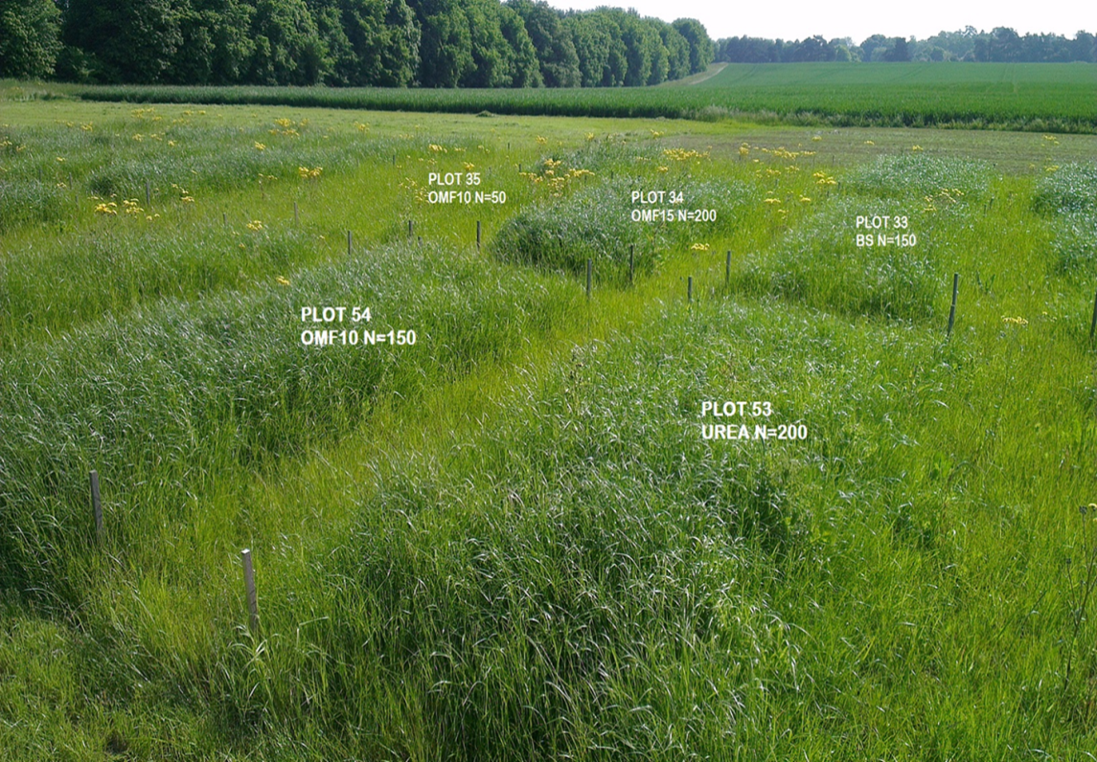
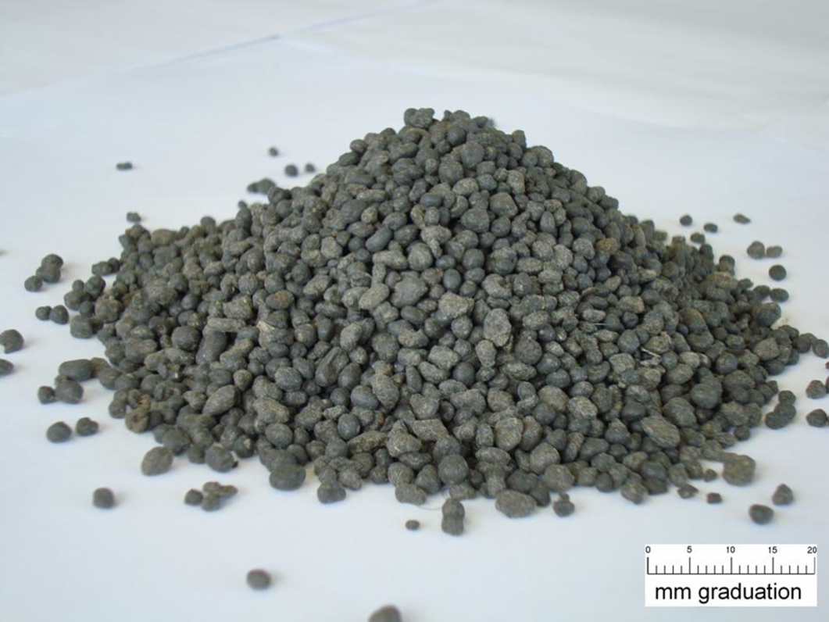

Nutrient Use Efficiency and Biosolids
Dr Richard Wadsworth, Dr Ruben Sakrabani, Dr Stephen Hallett
r.a.wadsworth@cranfield.ac.uk
21st September 2015

Slide 2
Background
Project is funded by SARIC (Sustainable Agriculture Research and Innovation Club) and NERC (Natural Environment Research Council) as an innovation not research project.
An attempt to make better use of academic knowledge in a practical, environmentally benign and economically useful way.

Slide 3
Our aims and objectives
Identify key environmental factors that influence Nutrient Use Efficiency,
Synthesise existing knowledge to generate spatially explicit data
Consult with stakeholders to determine the best use of biosolids
Disseminate knowledge through a “Data Hub” such as LandIS.
“Best” for SARIC ≈ efficient, resilient, sustainable?
“Best” for water companies ≈ trouble free, simple?
“Best” of EA ≈ material disaggregated in pure chemicals?
“Best” for environment ≈ BATNEEC (best available technology not entailing excessive costs) or BPEO (best practical environmental option)?

Slide 4
Nutrient Use Efficiency and Biosolids
Data mostly from experimental farms.
Data mostly small-scale and short-term (some exceptions)
Data mostly ignores management skill
Most experiments NUE of N
Most reports end by stressing importance of P
Crop uptake for at least 3 years after application of biosolids (complicates estimating the “Fertiliser Replacement Value”).
Tens of thousands of farmers have been using biosolids for decades, theoretically, there is large amounts of information on agronomic, economic and environmental effects, but …

Slide 5
Importance of Phosphate
Phosphate is a strategically important, non-renewable, heterogeneously distributed resource
Conventional agriculture depends on imported rock Phosphate (mostly from Morocco which has >80% of economically exploitable resource)
Biosolids contain usable concentrations of Phosphate
NUE of P is generally less than N, BUT, P uptake is very dependent on:
  Soil concentration
  Chemical form of the P compound
  Whether plant growth is limited by other nutrients
  Time period over which uptake is measured (years)
Phosphate can pollute, but, leaching from biosolids can be LESS than from conventional fertilisers.

Slide 6
Where’s the best place for biosolids?
Agronomic Need
“safe sludge matrix” allows application on many crops, but, most is on winter cereals or improved grass.
cereals ~ offtake in seed and straw
Improved grass ~ offtake in silage (usually) or hay
Soils ~ mid-point of “index 2” ~ 20 mg/l Olsen-P
Subject to constraints from:
Protected areas eg SSSI, National Parks, groundwater zones etc
Heavy metal accumulation etc
Risk of erosion and runoff etc
Economic costs etc

Slide 7
Data Flow

Slide 8
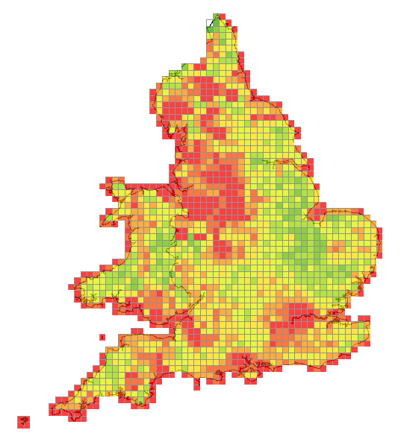
Where to use Biosolids
Agricultural Landbank Capacity Estimator (ALOWANCE) (developed by ADAS)
Issues:
10 km resolution
Primarily ability of agricultural land to absorb additional Nitrogen
(No measures of uncertainty / variability)
(No longer funded)
There is a more detailed version, but …
There also exist Slurry Acceptance Potential Models (based on soils, slope and climate etc)

Slide 9
Nutrient Use Efficiency
Meta-analysis suggests Biosolids and organo-mineral fertilisers slightly less effective than conventional fertilizers, but, lots of “noise” and not statistically significant.
Inter-annual variation (ie the weather) is the major source of variation.

Slide 10
Heavy Metals eg Cd
Total atmospheric Inputs of Cd in 2011
(wet + cloud + dry)
Most of England and Wales
< 600 mg/ha/yr
Atmospheric deposition ~53% of total input to agricultural land
(Rural monitoring network previously funded by Defra)
(Note recent experiments suggest that Zn and Cu more important for soil health)

Slide 11
National Soils Inventory
Cd in Soils
Point data with a 5km spacing.
Some high values can be related to:
Past land use, (eg low quality Phosphate fertilisers on Salisbury Plain),
Pollution, (eg Avonmouth Smelter),
Geology, (eg some marine clays)
Topography (eg high rainfall areas).

Slide 12
Monte Carlo Simulations of a Cd in Arable Soils
Crop – continuous wheat – yield 5 to 7 t/ha/yr
P₂O₅ requirement 28.9 to 43.1 kg/ha/yr
Assume no erosion, but some leaching
Assume objective to keep soil P more or less constant
Cd concentration in wheat 0.07 to 0.09 mg/kg DW
Cd atmospheric input 200 to 300 mg/ha/yr (wet + cloud + dry)
Runoff at 3 levels 0.15 to 0.45, 0.25 to 0.55 or 0.35 to 0.65 m/yr
Percentage P in biosolids 1.48% to 2.78% (inter-quartile range UU)
Concentration of Cd in biosolids 1.08 to 1.95 mg/kg (inter-quartile UU)
Concentration of Cd in conventional fertiliser 20 to 40 mg/kg
Conversion between P₂O₅ and P = 0.4364
Cd leaching depends on concentration in soil pore water
Concentration in soil pore water:
  Increases with concentration in the soil
  Decreases with soil pH (3 levels simulated 5.5, 6.5 & 7.5)
  Decreases with soil organic matter (3 levels simulated 1%, 3% & 5%)
  30 years simulation, 100 trials at each permutation of pH, OM and runoff range

Slide 13
Monte Carlo Simulation of Cd
Continuous application of Biosolids
Symbols median of 100 trials (different organic matter contents)

Slide 14
Monte Carlo Simulation of Cd comparison of Biosolids and conventional P₂O₅ fertiliser
Note Nicholson et al 2006, estimate 352 years of biosolid application to reach advisory level

Slide 15
Change in soil pH over last 20 years
(UU fields with planned application)
(sample of 100 fields)

Slide 16
Change in pH over 20 years
(all UU data)

Slide 17
Observed Change in Cd in Soils
(sample of 100 fields from UU data)

Slide 18
Observed changes in Cd
(all UU data)

Slide 19
National Soil inventory, extrapolation
National Soils Inventory – most comprehensive record of soil chemistry
Samples at 5 km intervals
Samples not chosen to be “representative” of the local landscape
Spatial auto-correlation is low
Interpolate NSI data by using median regression against soil associations, solid and drift geology and land use.
Median regression allows direct calculation of inter-quartile range for any soil property in the NSI (carbon, pH, P-Olsen etc)
Weighted average of predictions from the 4 regression equations where the “weight” is proportional the statistical significance of each class.
Example: from “drift geology”
  class “peat” = strong support (weight) for high soil carbon
  class “clay with flints” = no support for any level of soil carbon.

Slide 20
Example – Soil pH
(median estimate)

Slide 21
Combined data
Probability that soil pH < 5
White <25%
Green 25%-50%
Yellow 50%-75%
Blue >75%

Slide 22
Need for Phosphate
“Safe Sludge Matrix” allows application of biosolids to many crops.
Some “unexpected” constraints on biosolids eg not allowed on organic farms, not allowed on malting barley …
Modelled 2 crops, winter cereals and improved grass.
Area suitable for the 2 crops under current climate and predicted climate in 2050
Fertiliser recommendations from RB 209.

Slide 23
Land Suitable for Winter Cereals
(increase in suitable area by 2050)

Slide 24
P₂O₅ requirements Winter Wheat
(RB 209, Fertiliser recommendations)
Well suited = 8t/ha = 67 kg/P₂O₅
Moderately suited = 6 t/ha = 50 kg
Marginal = 4 t/ha = 34 kg
“Correction” for existing soil-P concentration
Soil P index 0 or 1 = + 40 kg
Soil P index 3 or more = – 40 kg

Slide 25
P₂O₅ requirements Silage & Hay
P₂O₅ = 141 – 3.49 * Soil_P
Suitability for improved grass = f(elevation, soil association, pH, organic matter, rainfall)
Farm Business Survey – relative area of hay v silage
RB 209 – fertiliser requirements by intensity (number of silage cuts) and soil P-index

Slide 26
Phosphate Acceptance Maps
Combined need from Winter Wheat plus improved grass under current climate and predicted for 2050
Subject to constraints / concerns by different stakeholder groups

Slide 27
Data Flow

Slide 28
Qualitative assessment of attitudes towards biosolids
Stakeholder | not used | problems |  | successful
 |  | Pollution / nuisance | Poor yields
Individual Farmers |  | ☹ | ☹☹ | ☺ ☺ ☺
Food industry |  | ☹☹☹
NFU |  | ☹ | ☹ | ☺
General public |  | ☹☹
Fertiliser producers | ☺ |  | ☺ | ☹
Fertiliser merchants/blenders |  | ☹ | ☹ | ☺
EA / Defra |  | ☹ ☹ ☹ |  | ☺ ☺
Water companies | ☹ | ☹ ☹ |  | ☺ ☺ ☺
DECC | ☹ ☹ | ☹ |  | ☺ ☺
SARIC / RC |  | ☹ ☹ | ☹ | ☺ ☺

Slide 29
Stakeholder groups and physical constraints
Constraint | Group 1 | Group 2 | Group 3 | Group 4 | Group 5
Protected Area - pollution | * | *
Protected Area - biodiversity | * |  | *
Protected Area - landscape | * |  | *
Heavy metal accumulation | * |  |  | *
Erosion > soil formation | * |  |  | *
Distance transported | * |  |  |  | *

Slide 30
Protected Areas – Pollution – (NVZ), NSA, Groundwater etc
Many multiple designations
NVZ considered a constraint on management and timing not on use.

Slide 31
Protected Areas – Biodiversity – SSSI, NNR, SAC, SPA etc
Many areas have multiple designations eg:
SSSI + NNR + SAC etc

Slide 32
Protected Areas – Landscape – AONB, National Parks etc
Data pending for Wales

Slide 33
Heavy Metal Accumulation – eg Ni (Nickel)
Atmospheric deposition
Median estimate in soil

Slide 34
Heavy metal accumulation – time to reach “Soil Screening Value”
Years to reach SSV
With continuous applications
Ni
Min(Cd, Cu, Pb, Ni, Zn)

Slide 35
Erosion – Pan-European Soil Erosion Risk Assessment
Red areas
erosion > 1.4 t/ha/yr
(optimistic estimate of soil formation)

Slide 36
Distance
2011 Census
Biosolids > 1km from urban areas
Biosolids < 25 km from urban areas
Urban areas > 100,000 people
Distance thresholds can be altered

Slide 37
Combining Constraints
SSSI etc
NP’s etc
NSA’s etc
Heavy metals
Erosion
Travel

Slide 38
Group 1
All Constraints
Constraints
P₂O₅ kg/ha/yr

Slide 39
Group 2
NSA, ESA & Groundwater
Constraints
P₂O₅ kg/ha/yr

Slide 40
Group 3
Biodiversity + Landscape
Constraints
P₂O₅ kg/ha/yr

Slide 41
Group 4
Heavy Metals & Erosion
Constraints
P₂O₅ kg/ha/yr

Slide 42
Group 5
Distance
Constraints
P₂O₅ kg/ha/yr

Slide 43
Implications …
800,000 tons/year biosolids
At 3% Phosphorous
At 1kg P = 2.29 kg P₂O₅
~ 55,000 tons of P₂O₅
British Survey of Fertiliser Use (Defra, 2012)
Total P₂O₅ England and Wales = 140,000 tons
(down from >300,000 tons 20 years ago)
Therefore, Biosolids ~ 1/3 of P₂O₅ needed

Slide 44
By Region … in 2015 …
Percentage of Agronomic need that could be met by biosolids
NUT 1 | Equivalent P₂O₅ t/yr | All constraints | Protected Areas - pollution | Protected Areas – Biodiversity | Heavy metals + Erosion | Distance
North-East | 2,604 | 760 | 168 | 12 | 17 | 24
North-West | 7,077 | 140 | 108 | 27 | 26 | 33
Yorkshire+Humber | 5,303 | 202 | 115 | 24 | 22 | 31
East-Midlands | 4,550 | 54 | 42 | 17 | 18 | 18
West-Midlands | 5,625 | 60 | 41 | 16 | 16 | 21
East-Anglia | 5,879 | 126 | 104 | 34 | 35 | 42
London | 8,228 | 22329 | 1105 | 623 | 583 | 6745
south-East | 8,678 | 97 | 59 | 33 | 23 | 25
South-West | 5,316 | 67 | 44 | 12 | 9 | 12
Wales | 3,073 | 45 | 14 | 7 | 8 | 21
Land suitable if the agronomic need is at least 25 kg P₂O₅/ha
Target is for soil to be in Index 2

Slide 45
By Region .. In 2050
(+23% biosolids + CC)
NUT 1 | tons equiv | All | PA poll | Pa bio | HM | Dist
North-East | 3202 | 838 | 151 | 13 | 19 | 28
North-West | 8704 | 175 | 133 | 32 | 32 | 40
Yorkshire+Humber | 6523 | 226 | 130 | 28 | 25 | 35
East-Midlands | 5597 | 67 | 52 | 21 | 22 | 22
West-Midlands | 6919 | 73 | 50 | 20 | 20 | 26
East-Anglia | 7231 | 159 | 130 | 43 | 44 | 52
London | 10120 | 27465 | 1356 | 765 | 717 | 8256
south-East | 10674 | 116 | 70 | 39 | 27 | 30
South-West | 6539 | 81 | 53 | 14 | 11 | 15
Wales | 3780 | 62 | 18 | 9 | 10 | 24
Biosolids meet fractionally more of the agronomic demand

Slide 46
Summary
Application of Biosolids to land is the BPEO
A water treatment works is a Phosphate mine
There is “inertia” in water treatment systems due to; capital costs, public perception etc.
Stakeholders can be grouped depending on common interests
Under some scenarios the “land-bank” is already insufficient.

Slide 47
Discussion Points
Where would you like future research to go?
What additional data could enhance future research?
Does your organisation “map” onto these four stakeholder groups?
Is accessing and dissemination through LandIS sufficient?

